Slide 1

The Role of Context in Memory Storage and Retrieval
Lea (Shuchun) Lai, Indiana University
Richard Shiffrin, Indiana University
ASIC 2024 Molveno

Slide 2
Context plays a fundamental role in theories of memory storage and retrieval. What is context? How is it different than content?

Slide 3
Content
1.Content
When an event is stored in memory, some of the information is called ‘content’.
Content: The specific information that distinguishes one event from the others in the same setting.
Example: Studying Words “TABLE”
When studying a list of words, each word's content includes its visual form, spelling, and meaning.
For example, the word "TABLE" is stored with its unique attributes.
This content information differentiates "TABLE" from another word on the same list, like "BOOK."
Shared Context
Both "TABLE" and "BOOK" were studied in the same overall context, but their content distinguishes them.

Slide 4
Context
Context
The background information surrounding an event when it is stored in memory.
Example: Studying "TABLE"
When studying the word "TABLE," the memory includes: The room, equipment, weather, mood, bodily sensations, sounds, people nearby, and other related aspects.

Slide 5
Context’s Role in Retrieval
1. Importance of Context in Retrieval
Context is essential for focusing retrieval on specific events of interest.
Event storage and retrieval is also called episodic memory
2. Example: Recognizing "TABLE"
When asked to recognize if "TABLE" was on the recently presented list, context helps pinpoint this recent occurrence.
It distinguishes the recent memory from numerous other times "TABLE" has been encountered.
3. Dynamic Nature of Context
Context is believed to change over time and as new events occur (Mensink & Raaijmakers, 1988).
Notes:
premises

Slide 6
How to focus on context?
Current context
Using Current Context
Most memory studies use the current context during testing to probe retrieval.
This method focuses retrieval on recent events.
Past context
Reconstructing Past Context
To retrieve past events, can reconstructing the context at the time of storage help?
Limited research exists on this, but recent evidence by Bauml and colleagues suggests it may be possible (Bauml & Trissl, 2022).

Slide 7
More about Context from Laboratory Experiment
Difference of Context Dynamics During Study and Test
Context remains relatively stable while studying a list of items.
Significant changes occur between studying and testing phases.
Context evolves more during testing than during study (Klein, Shiffrin & Chris, 2007)
Automatic Storage of Context
Context information is automatically stored for a brief period (a few seconds).
Additional study time is typically focused on storing content, such as the meaning of the items (Malmberg & Shiffrin, 2005).
Integration of Context and Content
Context may be integrated with content or stored separately.
This integration varies depending on the nature of the memory task (Murnane, Phelps & Malmberg, 1999).
Notes:
Cite first point?

Slide 8
Present Study, Objective and Design (Study 1&2)
Study Objective
The study aims to shed light on the role of context in memory.
The first goal is to develop a detailed model within the REM framework, given its proven effectiveness.
In the future, we will examine other models as well
Study 1: Recognition for Pictures
Participants were tested on their ability to recognize pictures.
Study 2: Cued Recall for Words
Participants were tested on their ability to recall paired/nonpaired words with cues.
Study Design
Both studies had similar designs, measuring accuracy and response time.
Today’s presentation will focus solely on the accuracy results in study 1 on picture recognition.

Slide 9
Picture Recognition Study Procedure (Overview)
Initial Test (Study and Recognition):
10 lists, each including 20 study pictures and 20 tests
Final Test (Testing only):
Continuous tests of all from initial
Forward group
List 1
List 1 2 ...
Backward group
List 10 9 ...
Random group
List 10
Randomly mixed across list

Slide 10
Procedure for Picture Recognition in Initial Test
1. Study Phase
Participants studied a list of 20 pictures.
2. Testing Phase
After an arithmetic counting break,
participants were tested on their recognition:
Targets: 10 pictures from the studied list.
Foils: 10 new pictures not previously studied.
3. Repetition
This process was repeated for 10 different lists.
Participants were aware that targets were only from the list just studied, and foils were always completely new.
List 1
List 10

Slide 11
Final Test Procedure
Instruction Break, followed by final Recognition Test:
Participants were tested on every kind of pictures encountered in the initial part of the session
Final TARGETS (3 kinds)
Items studied but not tested initially (10 per list, 7 selected).
Items studied and tested initially as targets (10 per list, 7 selected).
Items tested only initially as foils (10 per list, 7 selected).
Total: 210 final targets (3*7*10).
List 1
Final FOILS:
The 210 final targets were mixed with 210 entirely new foils.
Participants needed to respond "OLD" for final TARGETS and "NEW" for new FOILS.
List 10
Notes:
Foil studied origianll, now targets

Slide 12
Final Testing Groups
Random Group: Final targets and foils were randomly mixed across lists.
Forward Group:
Testing began with targets from the first list studied.
Proceeded with the next initial list until all pictures were tested.
Backward Group:
Testing began with targets from the last list studied.
Proceeded with the next-to-last initial list until all pictures were tested.
Random group
Randomly mixed across lists
Forward group
List 1 2 ...
Backward group
List 10 9 ...

Slide 13
Participant Recruitment and Testing Information
Instructions for Forward and Backward but not for Random group:
Purpose of Forward and Backward Groups
Participant Recruitment
Informed about the order of final testing.
Before each set of 42 tests, they were told which initial list the new targets were from.
Designed to assess if knowing the initial list helps use context appropriately.
Aimed to determine if this knowledge leads to better retrieval compared to the Random group.
Participants were recruited online through Prolific.
50 participants each in forward/backward; 100 in random condition

Slide 14
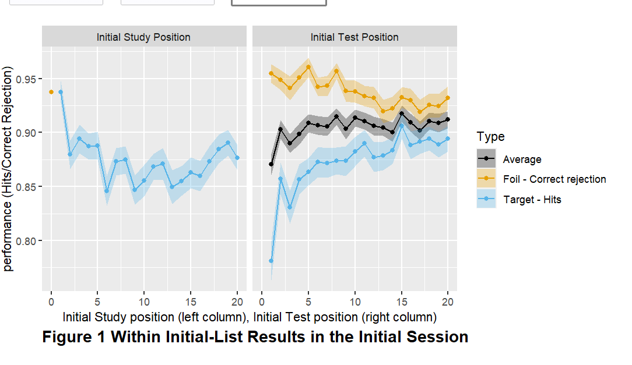
Within list results during Initial Testing:
Notes:
Point to the dot while presenting the left column panel, make sure say black is average

Slide 15
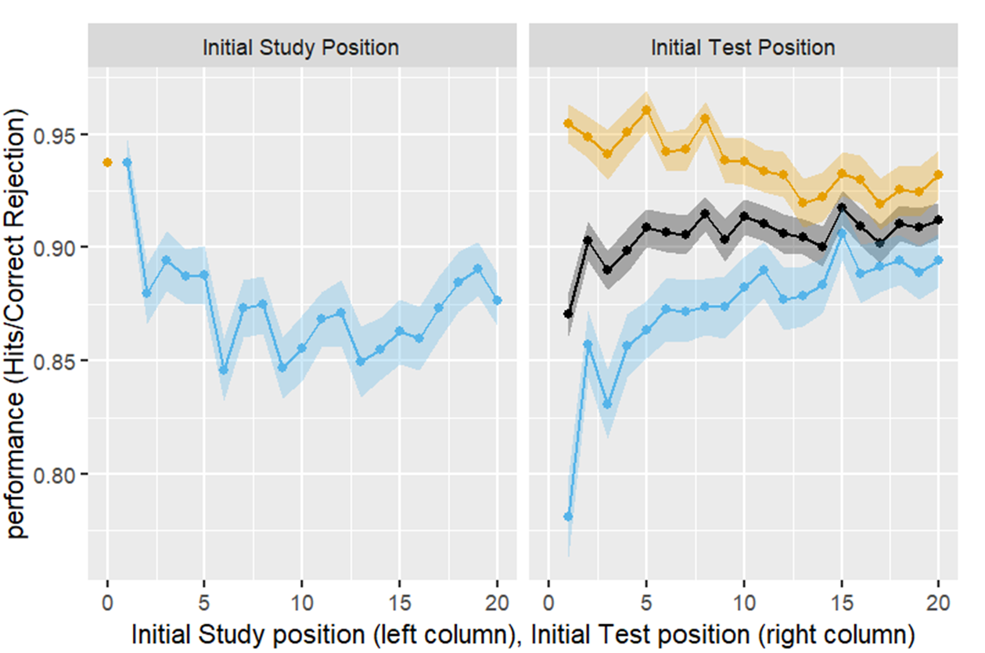

Within list results during Initial Testing
Primacy and Recency Effects (Study position)
Analysis by study position shows some primacy and a small amount of recency.
Output Interference (OI; Test position)
No evidence of OI for the 10 target and 10 foil tests for pictures.
Previous research found strong OI for words with more than ten tests.
Higher CRs than Hs
Higher correct responses to foils ('correct rejections' or CRs) than to targets ('hits' or Hs).
Difference decreases as testing continues.
Notes:
Strengthening predict output interference
Reasons to strengthen: answer list strengthen effect
(Criss, Malmberg, Shiffrin, 2011)
(Kilic, Criss, Malmberg, Shiffrin, 2017)

Slide 16
Current Model -- Storage During Testing
Storage of Information During Testing
Tests judged NEW cause storage of a new trace.
Tests judged OLD often involve trace recall, which is strengthened by adding information from the test item (Criss, Malmberg & Shiffrin, 2011; Kilic, Criss, Malmberg & Shiffrin, 2017).
REM (1997)
Strengthening a trace reduces its similarity to different test items tested later.
This shift increases correct rejections and decreases hits for later items.
🡪 Lower similarity, lower odds, lower Hs, higher CRs
Adding a Filter
A filter prevents activation of traces that poorly match the probe in context and content.
Strengthened traces become less similar, so the filter tends not to activate them.
This could potentially decrease correct rejections, increase hits, and amplifies these effects as testing continues.

Slide 17
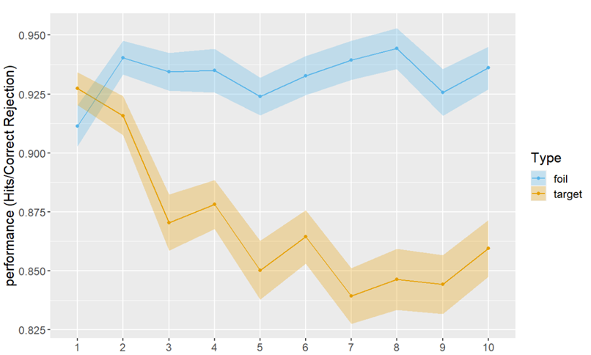
Between-List Results during Initial Testing
Performance Decline Over Lists
There is a decrease in Hs.
The decrease in Hs may be due to the activation of traces from prior lists. (Aligned with Osth and Denis’s work on “context noise” from prior lists)
The reason this decline is observed only for hits depends on the specifics of how the REM model is extended.
REM Model Predictions
REM generally predicts that correct rejections (CRs) will be higher than hits (Hs) on average.
List number in initial test
Notes:
Intiial lack an “L” here.
Fix the plot here.
Osth, Denis, have been looking list length effect, and this kind of interference is called by “context noise” from prior lists.
Our model assume accumulated tarces, activate item from prior lists

Slide 18
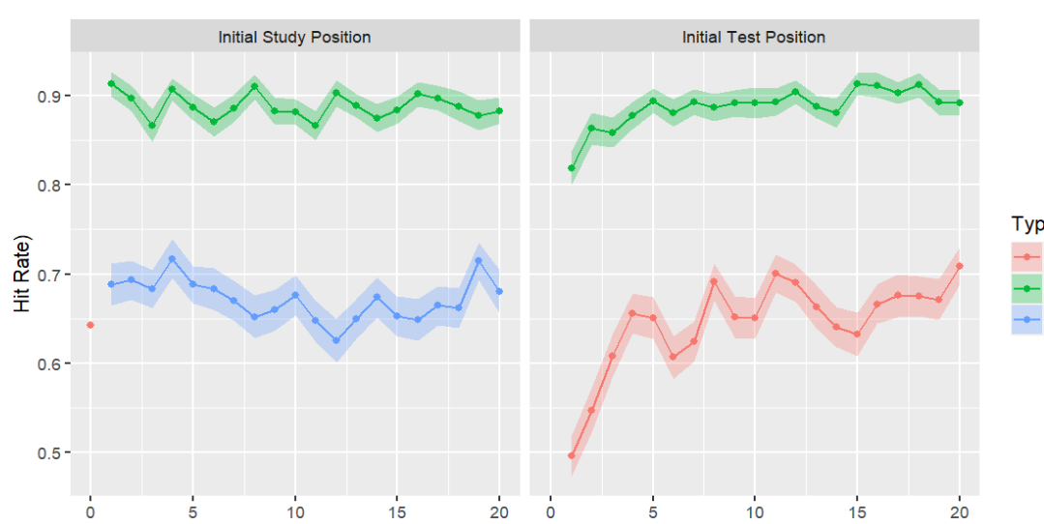
Within-List Final test results - Averaged across 3 groups
Hits:Tested only (previous foil) – Hs
Hits Studied and tested (previous target) - Hs
Correct Rejection Studied only -
Initial Study Position
Initial study position has little impact on final testing performance.
Initial Test position
Items tested later in each list are better recognized in final testing.
Possible reason: Targets tested later may have a higher chance of recalling their trace due to associations with pictures recalled earlier in testing.
Notes:
Ask for potential interpretations , (FIT Kahana group’s work)

Slide 19
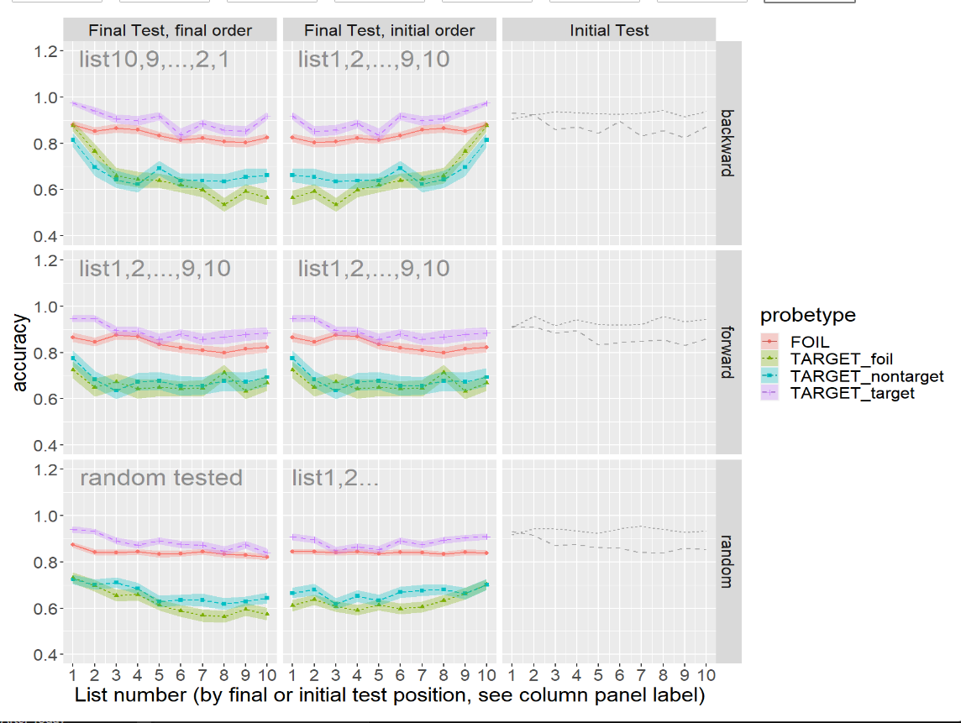
Between-List Final Test Results (by initial or final test order)
Don’t look at the lines here, the plot is just for illustration!!

Slide 20
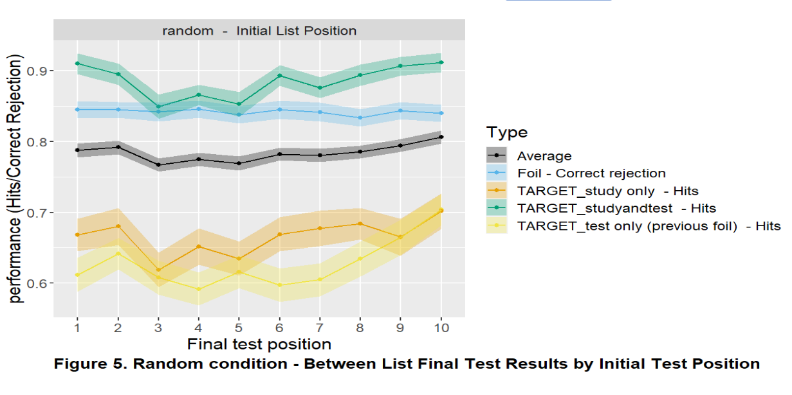
Between List Final Test Result (by initial list position)
Arranging by Initial list position for random condition best shows primacy/recency effect
Modest primacy and recency effects.
Striking observation
Pictures studied only and tested only earlier show similar, poor performance.
Suggests both produced similar strength traces—one during study, the other during testing.
Superior performance for study and tested
Items both studied and tested perform much better.
Likely due to trace storage and strengthening during testing.
Initial List Position

Slide 21
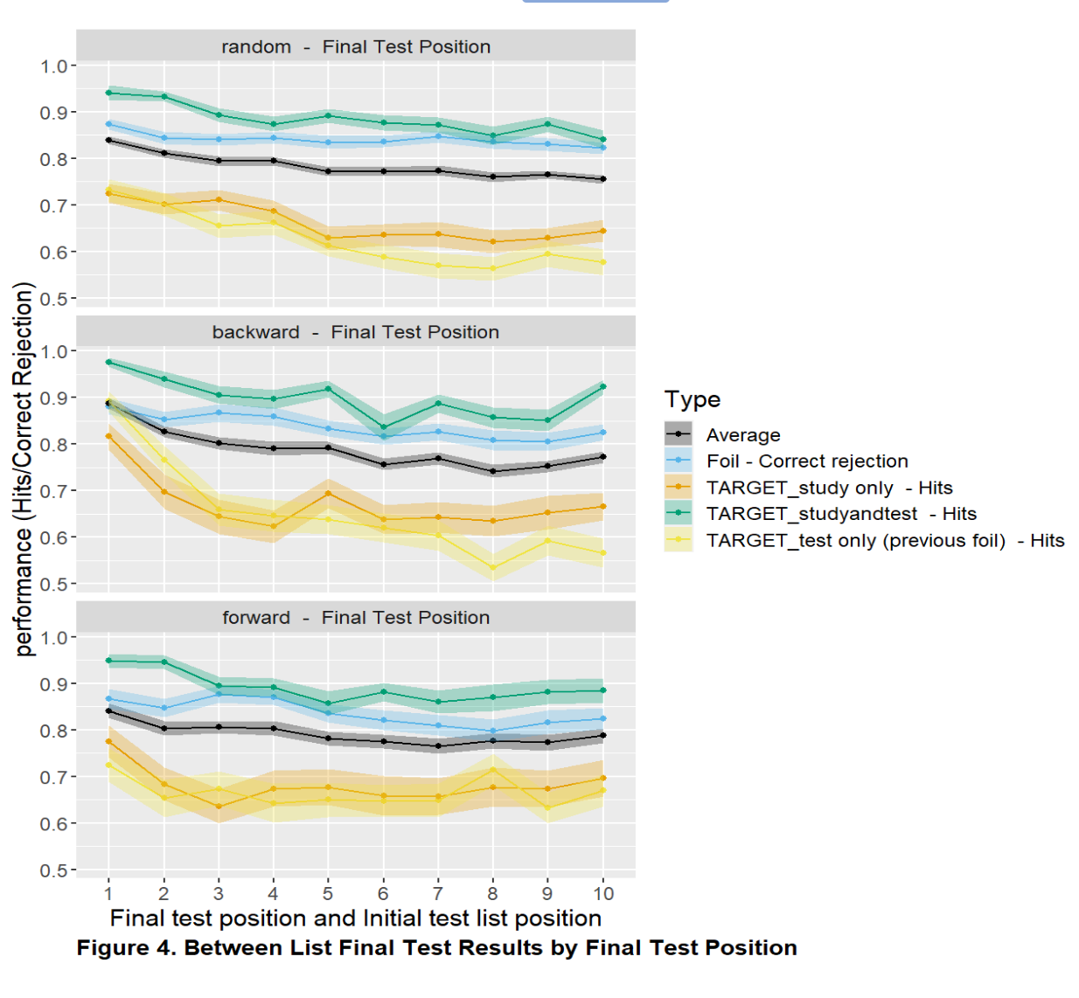
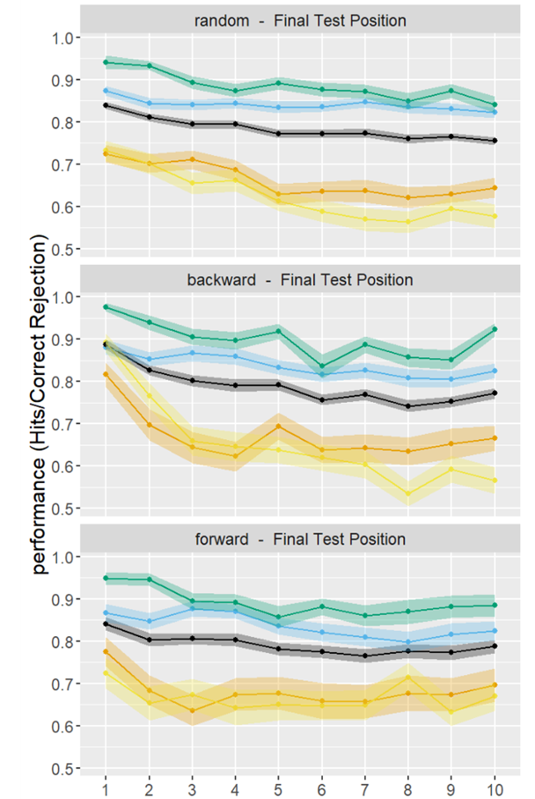
Between-List Final Test Result (by final test position)
Output Interference (OI)
Analysis by final testing position shows output interference (OI), as expected.
Differences in OI
Some differences in OI observed between random, forward, and backward conditions.
These differences might suggest the use of different context cues in each condition.
Need for Further Modeling
The existence and significance of these effects require careful modeling to be established.
List 10, 9, …., 2, 1
List 1,2, …., 9, 10
Final Test Position

Slide 22
Conclusion
Building a Model of Context
The experiments provide crucial data for building and refining our model of context.
Whether using the REM model or another framework, these findings are instrumental.
Experiment Design
The experiments are meticulously designed to enhance our understanding of context in memory storage and retrieval.
Notes:
The experiments help to build our model of context, whether we model with REM or any other model.
The experiments are designed to help understanding of context.

Slide 23
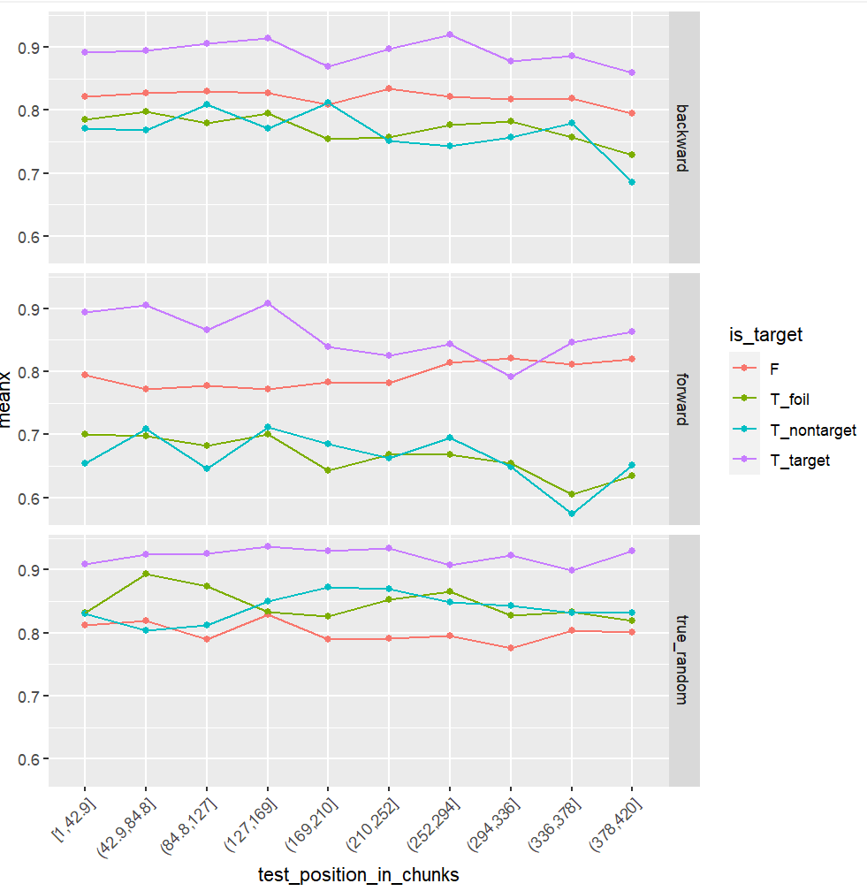
List 10, 9, …., 2, 1
List 1,2, …., 9, 10
Final Test Position

Slide 24
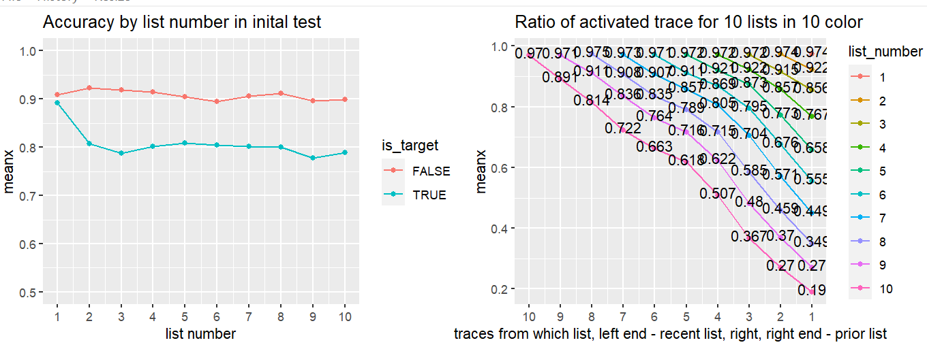
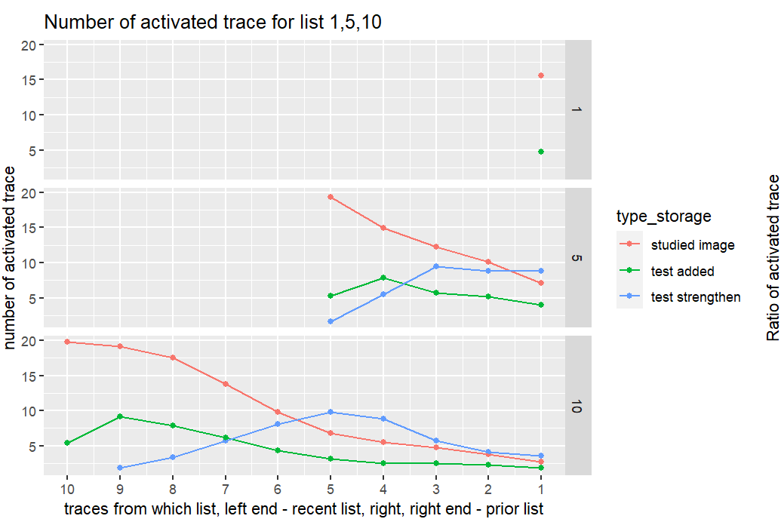
Model result

Slide 25
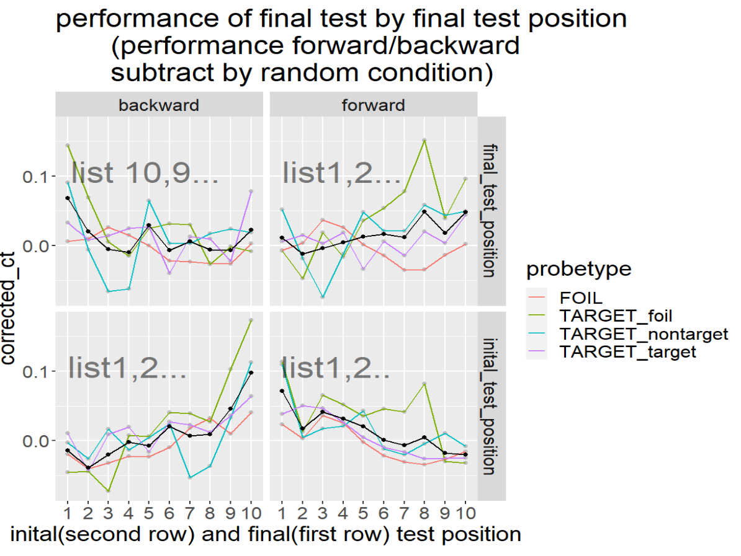
After subtraction
The random condition, when scored by initial list position, provides a measure of recency. Conversely, when scored by final test position, it measures output interference. For the forward or backward conditions, it would be informative to subtract the corresponding measures from the random conditions.
Alternatively, the random condition can be considered as representing the combined effects of both recency and output interference. This combined measure can then be used to adjust and remove these effects from the forward and backward conditions.

Slide 26
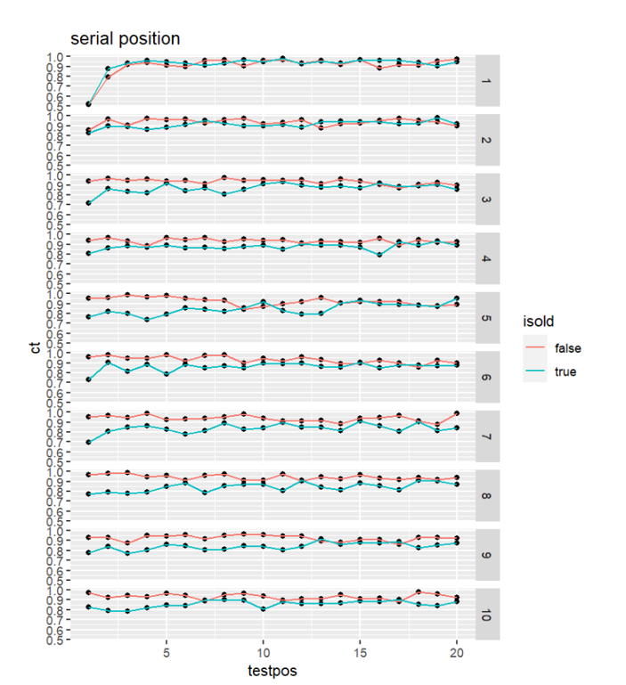
Detail Serial position result

Slide 27
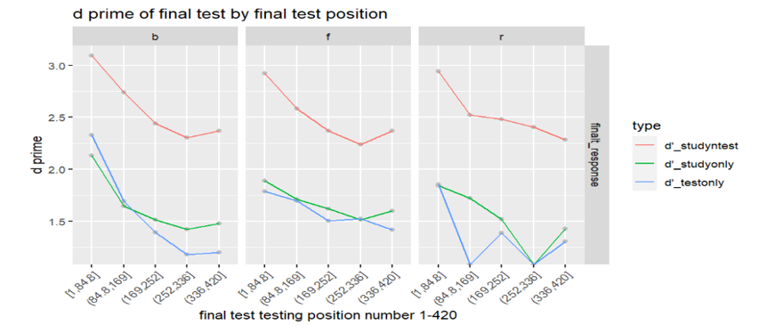
D prime result in final test

Slide 28
Final Test Result in Matrix

Slide 29
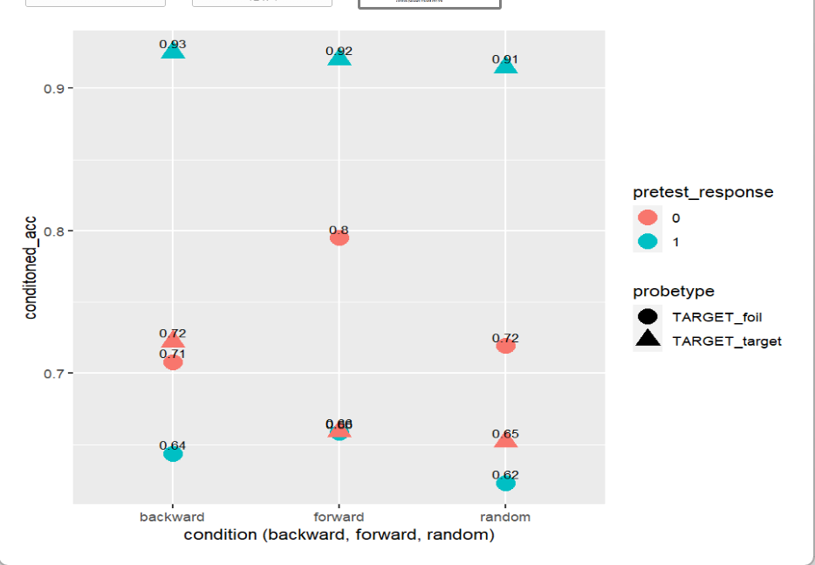
Conditional plot
When you say foil as foil earlier, the worse performance
When you say target as target ealier, the best performance

Slide 30
